Slide 1

ML For Mind Sharpeners
Saeed Salehi

Slide 2


Who Am I?
Saeed is like a superhero 🦸‍♂️ but instead of fighting crime, he fights bugs 🐛 as a software engineer. He's so good at debugging, he could probably fix a glitch in the Matrix! 💻
But he's not just all code and no humor 😂, he knows that sharing his mistakes and experiences can help others and make the world a better place, one line of code at a time 👨‍💻 🤘
@1saeedsalehi | https://1saeed.dev

Slide 3
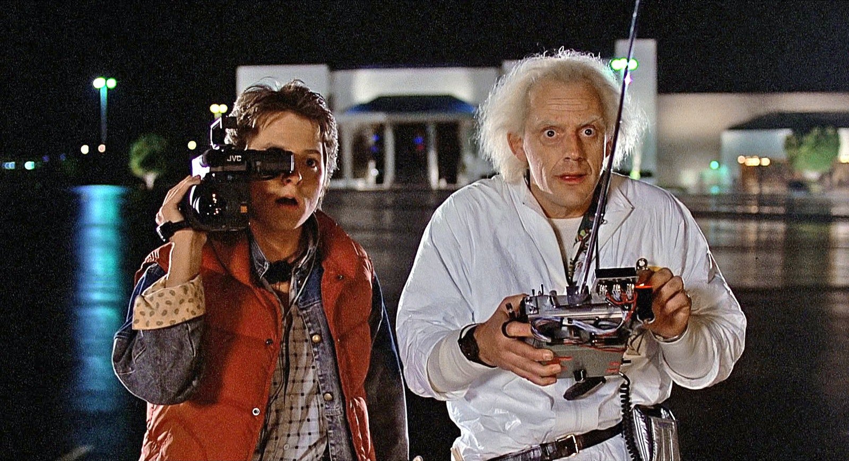
We don’t have a PhD (heb je misschien!) We are not a data scientist

Slide 4
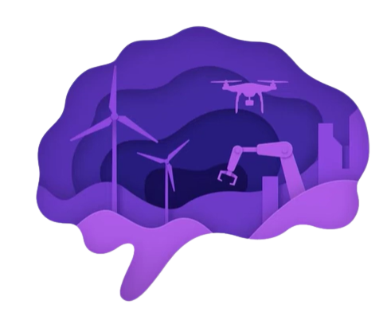
What is it about?
It’s Programming the Unprogrammable program computers
To use Example Data or Past Experience
To solve a problem

Slide 5
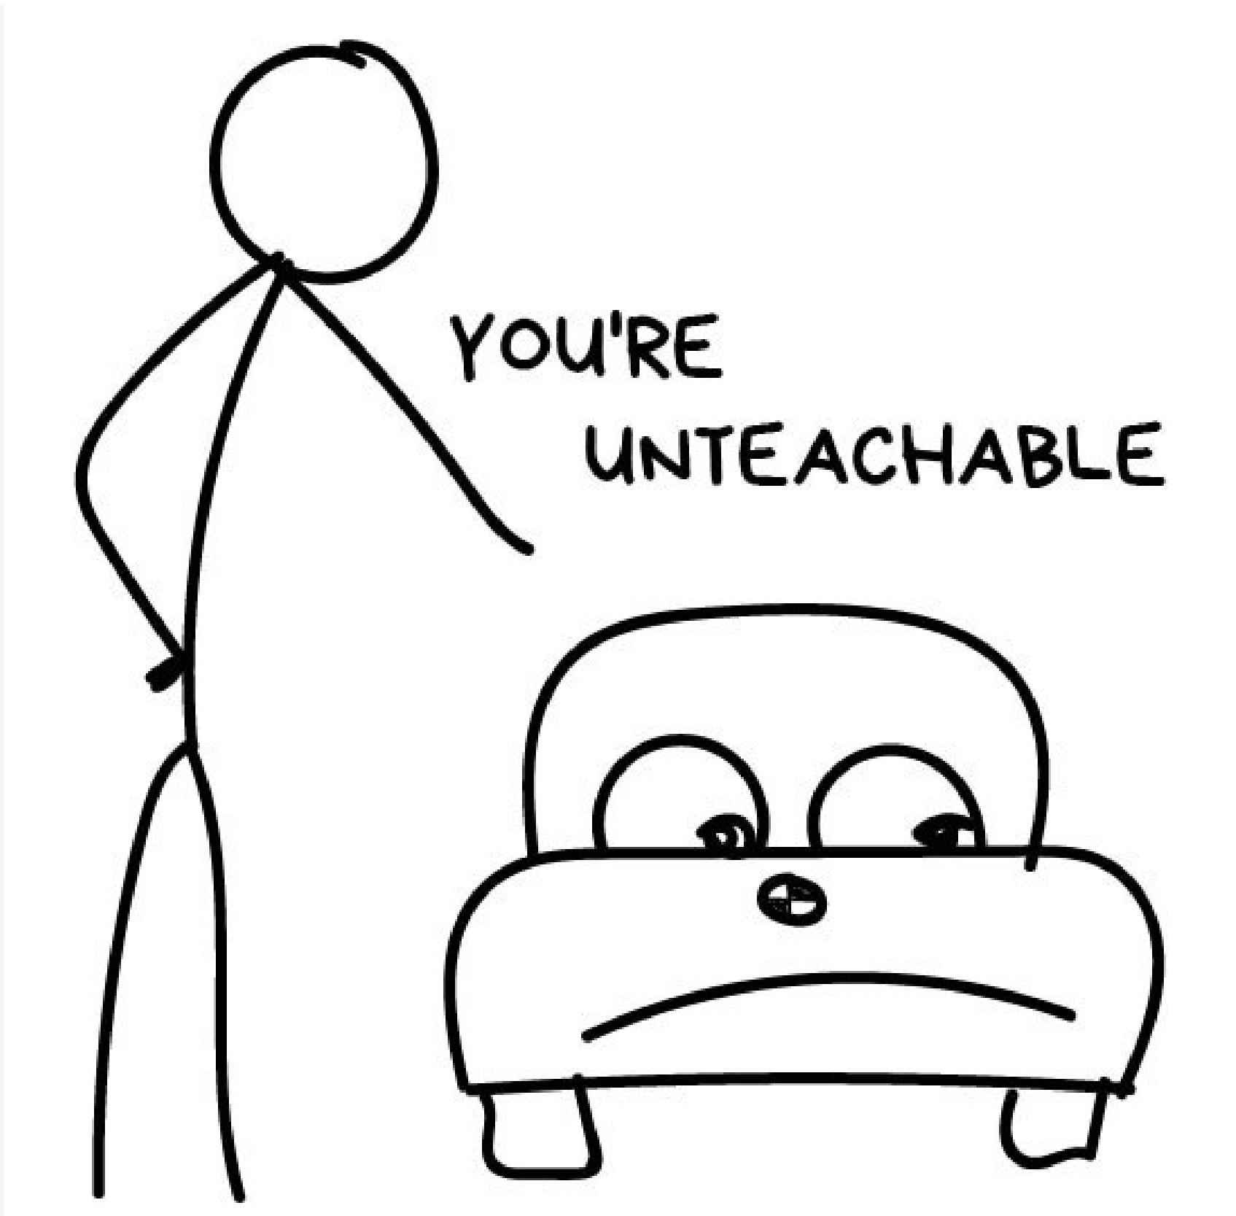
Notes:
This is Billy. Billy wants to buy a car. He tries to calculate how much he needs to save monthly for that. He went over dozens of ads on the internet and learned that new cars are around $20,000, used year-old ones are $19,000, 2-year old are $18,000 and so on. Billy, our brilliant analytic, starts seeing a pattern: so, the car price depends on its age and drops $1,000 every year, but won't get lower than $10,000. In machine learning terms, Billy invented regression – he predicted a value (price) based on known historical data. People do it all the time, when trying to estimate a reasonable cost for a used iPhone on eBay or figure out how many ribs to buy for a BBQ party. 200 grams per person? 500? Yeah, it would be nice to have a simple formula for every problem in the world. Especially, for a BBQ party. Unfortunately, it's impossible. Let's get back to cars. The problem is, they have different manufacturing dates, dozens of options, technical condition, seasonal demand spikes, and god only knows how many more hidden factors. An average Billy can't keep all that data in his head while calculating the price. Me too. People are dumb and lazy – we need robots to do the maths for them. So, let's go the computational way here. Let's provide the machine some data and ask it to find all hidden patterns related to price. Aaaand it works. The most exciting thing is that the machine copes with this task much better than a real person does when carefully analyzing all the dependencies in their mind. That was the birth of machine learning.

Slide 6
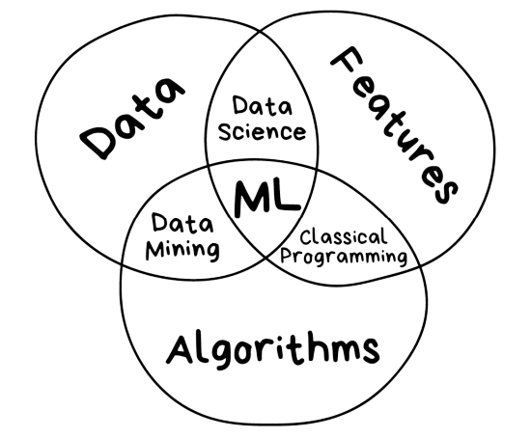
Three components of machine learning
Notes:
Without all the AI-bullshit, the only goal of machine learning is to predict results based on incoming data. That's it.
All ML tasks can be represented this way, or it's not an ML problem from the beginning.
The greater variety in the samples you have, the easier it is to find relevant patterns and predict the result.
Therefore, we need three components to teach the machine:
------------------------------------------ Data: Want to detect spam? Get samples of spam messages. Want to forecast stocks? Find the price history. Want to find out user preferences? Parse their activities on Facebook (no, Mark, stop collecting it, enough!) . The more diverse the data, the better the result. Tens of thousands of rows is the bare minimum for the desperate ones
------------------------------------------- Features: Also known as parameters or variables. Those could be car mileage, user's gender, stock price, word frequency in the text. In other words, these are the factors for a machine to look at. When data stored in tables it's simple — features are column names. But what are they if you have 100 Gb of cat pics? We cannot consider each pixel as a feature. That's why selecting the right features usually takes way longer than all the other ML parts. That's also the main source of errors. Meatbags are always subjective. They choose only features they like or find "more important". Please, avoid being human.
--------------------------------------------
Algorithms: Most obvious part. Any problem can be solved differently. The method you choose affects the precision, performance, and size of the final model. There is one important nuance though: if the data is crappy, even the best algorithm won't help. Sometimes it's referred as "garbage in – garbage out". So don't pay too much attention to the percentage of accuracy, try to acquire more data first

Slide 7
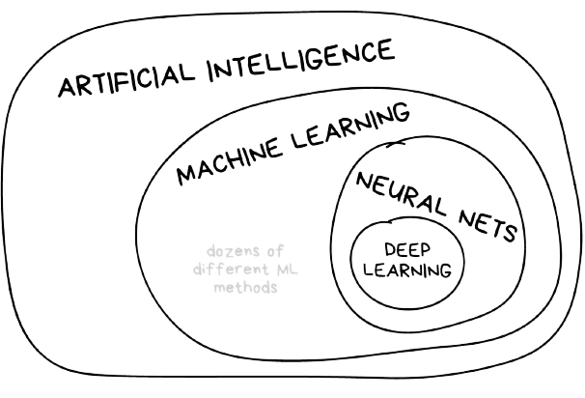
Notes:
Artificial intelligence is the name of a whole knowledge field, similar to biology or chemistry. Machine Learning is a part of artificial intelligence. An important part, but not the only one. Neural Networks are one of machine learning types. A popular one, but there are other good guys in the class Deep Learning is a modern method of building, training, and using neural networks. Basically, it's a new architecture. Nowadays in practice, no one separates deep learning from the "ordinary networks". We even use the same libraries for them. To not look like a dumbass, it's better just name the type of network and avoid buzzwords The general rule is to compare things on the same level. That's why the phrase "will neural nets replace machine learning" sounds like "will the wheels replace cars". Dear media, it's compromising your reputation a lot

Slide 8
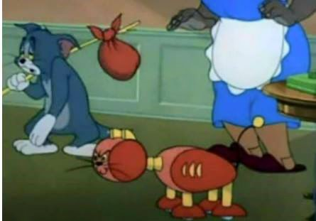
Tom was the first one who replaced by AI

Slide 9
What’s the difference?
Artificial Intelligence
Ability of a computer to perform tasks commonly associated with intelligent beings (reason , discover, meaning , generalize, learn from experience)
Machine Learning
Getting computers to make predictions without being explicitly programmed
Deep learning
Subset of ML based on artificial neural networks which imitate the way the human brain learns , thinks and process data
AI
Machine Learning
Deep learning

Slide 10
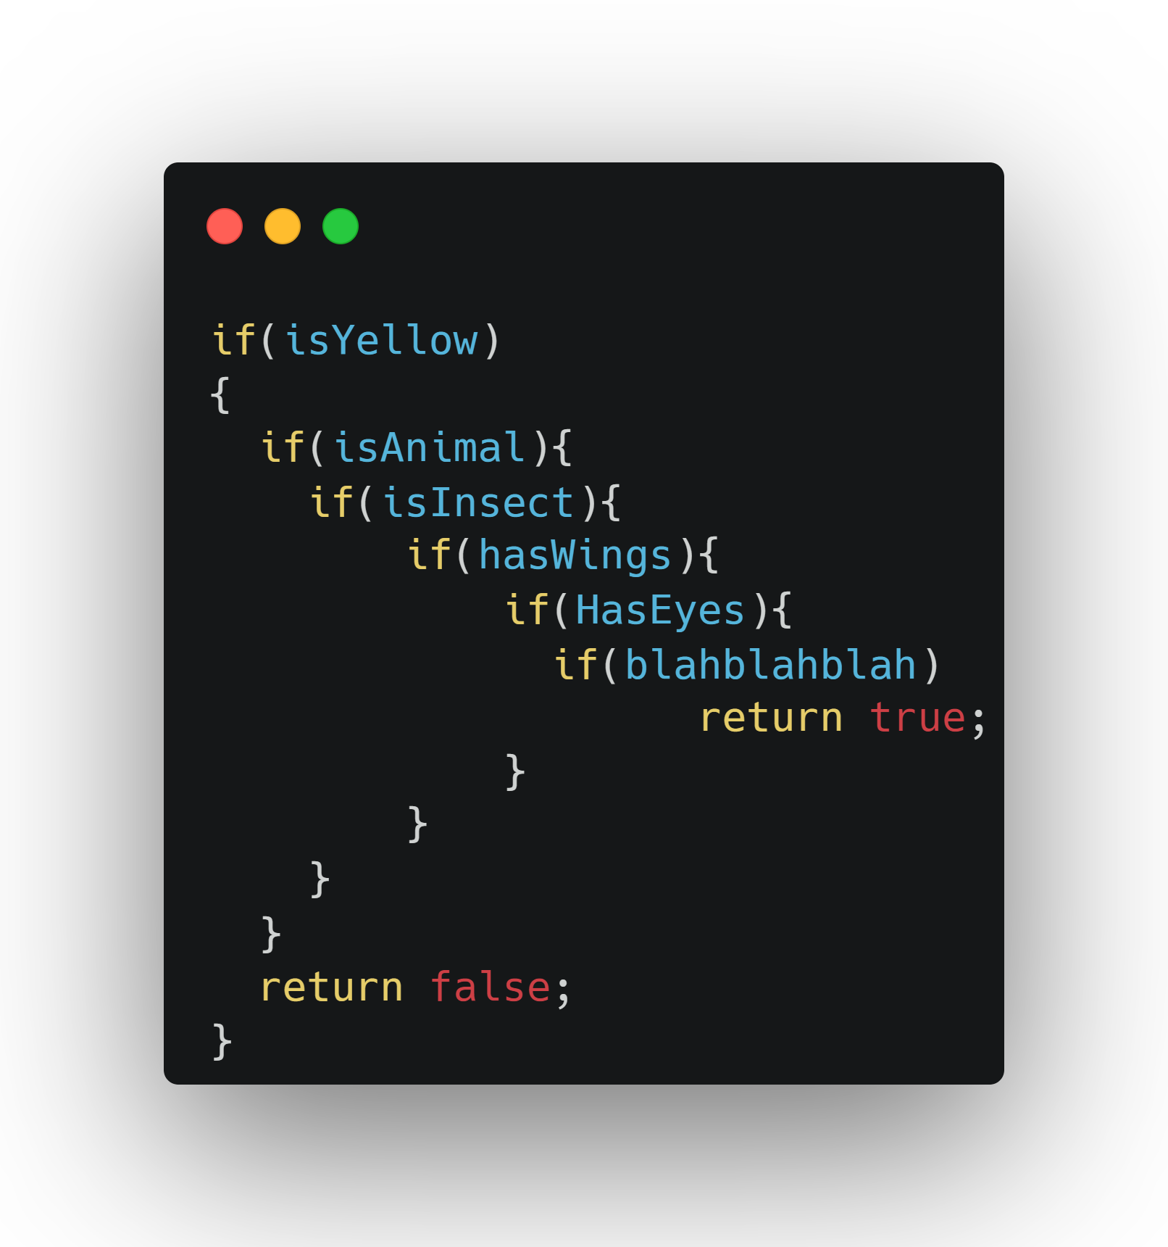


Classic Artificial Intelligence
Bee or not to Bee? That’s the question :)

Slide 11
Mechanical Turk?
See the explanation

Slide 12
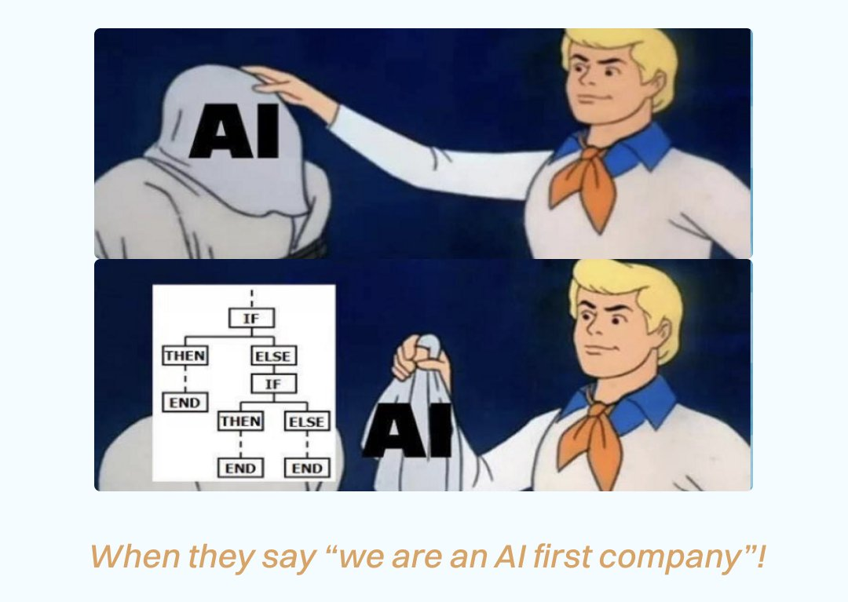

Slide 13
Comparison
Artificial Intelligence
Machine Learning
Rules
Data
Answers
Data
Answers
Rules

Slide 14
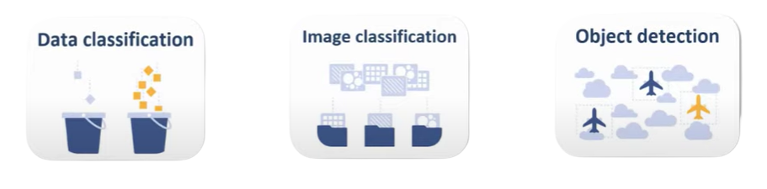
What kind of problems can be solved with ML?
Categorize Items
Notes:
classification – an object's category prediction "Splits objects based at one of the attributes known beforehand. Separate socks by based on color, documents based on language, music by genre ----------------------------------------------------------------

Slide 15
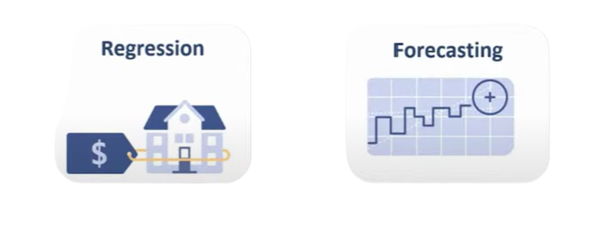
What kind of problems can be solved with ML?
Predict a value or number
Notes:
Regression : Regression is basically classification where we forecast a number instead of category. Examples are car price by its mileage, traffic by time of the day, demand volume by growth of the company etc. Regression is perfect when something depends on time ----------------------------------------------------------------------------------

Slide 16

What kind of problems can be solved with ML?
Make suggestion
Notes:
"Assembles specific features into more high-level ones" Nowadays is used for: Recommender systems (★) Beautiful visualizations Topic modeling and similar document search Fake image analysis Risk management if you use it to abstract user ratings, you get a great system to recommend movies, music, games and whatever you want.

Slide 17
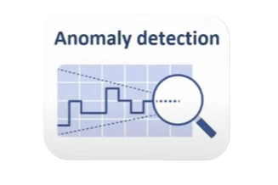
What kind of problems can be solved with ML?
Find outliers
Notes:
There's one very useful side of the classification anomaly detection. When a feature does not fit any of the classes, we highlight it. Now that's used in medicine on MRIs, computers highlight all the suspicious areas or deviations of the test. Stock markets use it to detect abnormal behaviour of traders to find the insiders. When teaching the computer the right things, we automatically teach it what things are wrong.

Slide 18
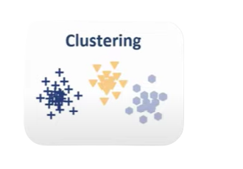
What kind of problems can be solved with ML?
Find relationships
Notes:
Divides objects based on unknown features. Machine chooses the best way" Nowadays used: For market segmentation (types of customers, loyalty) To merge close points on a map For image compression To analyze and label new data To detect abnormal behavior

Slide 19
Types of learning
Supervised Learning
Have labeled data (already tagged with right answer)
Try to find label of new data
Unsupervised learning
Do not have labeled data
Finds unknown patterns in data
Notes:
Supervised Learning : in the first case, the machine has a "supervisor" or a "teacher" who gives the machine all the answers, like whether it's a cat in the picture or a dog. The teacher has already divided (labeled) the data into cats and dogs, and the machine is using these examples to learn. One by one. Dog by cat.
---------------------------------------------------------------------------------------------------
unsupervised Learning :
Unsupervised learning means the machine is left on its own with a pile of animal photos and a task to find out who's who.
Data is not labeled,
there's no teacher, the machine is trying to find any patterns on its own.
We'll talk about these methods below

Slide 20
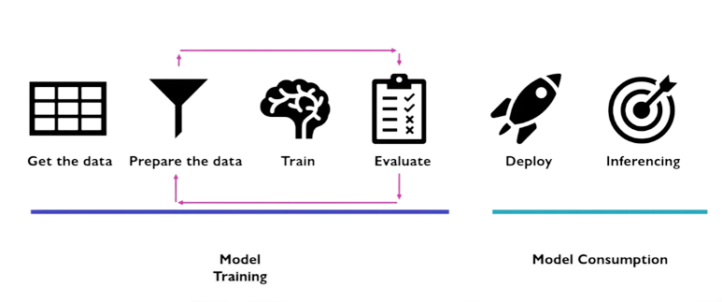
Workflow

Slide 21
Supervised Learning Iris Flower Classification

Slide 22
Unsupervised Learning Iris Flower Classification

Slide 23
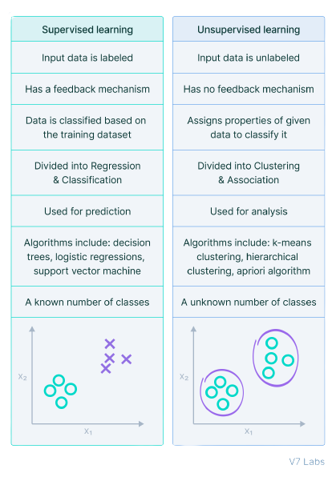

Slide 24

What is ML .Net?
ML.NET is a free, open-source, and cross-platform machine learning framework, created by Microsoft, for the .NET developer platform.

Slide 25
How ML.Net Helps us?
Build
Train
Evaluate
Consume

Slide 26

Demo time!

